Slide 1

Chinese box office analysis
Interpreting International Film Performance in Mainland China

Slide 2
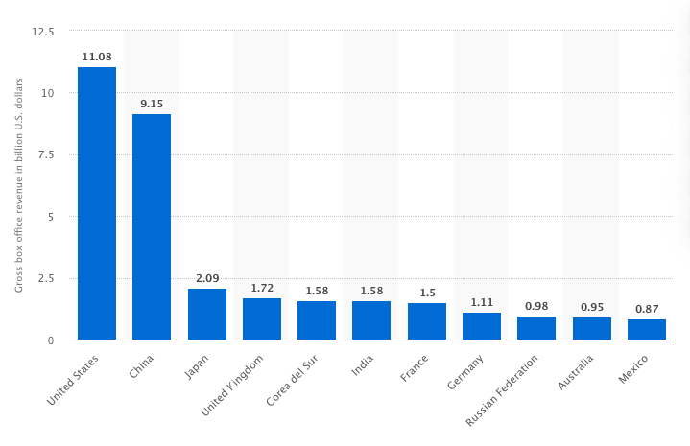
What drives second largest box office in the world?
Mainland Chinese box office revenue alone constitutes roughly 1/3 of the global market
Greater understanding of this market can significantly boost worldwide film revenue
© Statistia 2020

Slide 3
Methodology

Slide 4
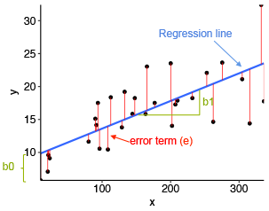
Methodology
GOAL:
Generate key insights to improve international film marketing strategy
PROCESS:
use linear regression to interpret total gross revenue of internationally released films in the mainland Chinese market

Slide 5

Methodology
All data scraped from the following sources:
Box Office Mojo — worldwide box office data 1994-2020
— out of ~16K films total, only ~800 released in China
— HK excluded since it requires a unique marketing approach
The Numbers — top 100 earning international actors
Wikipedia — top 10 highest-grossing film directors worldwide

Slide 6
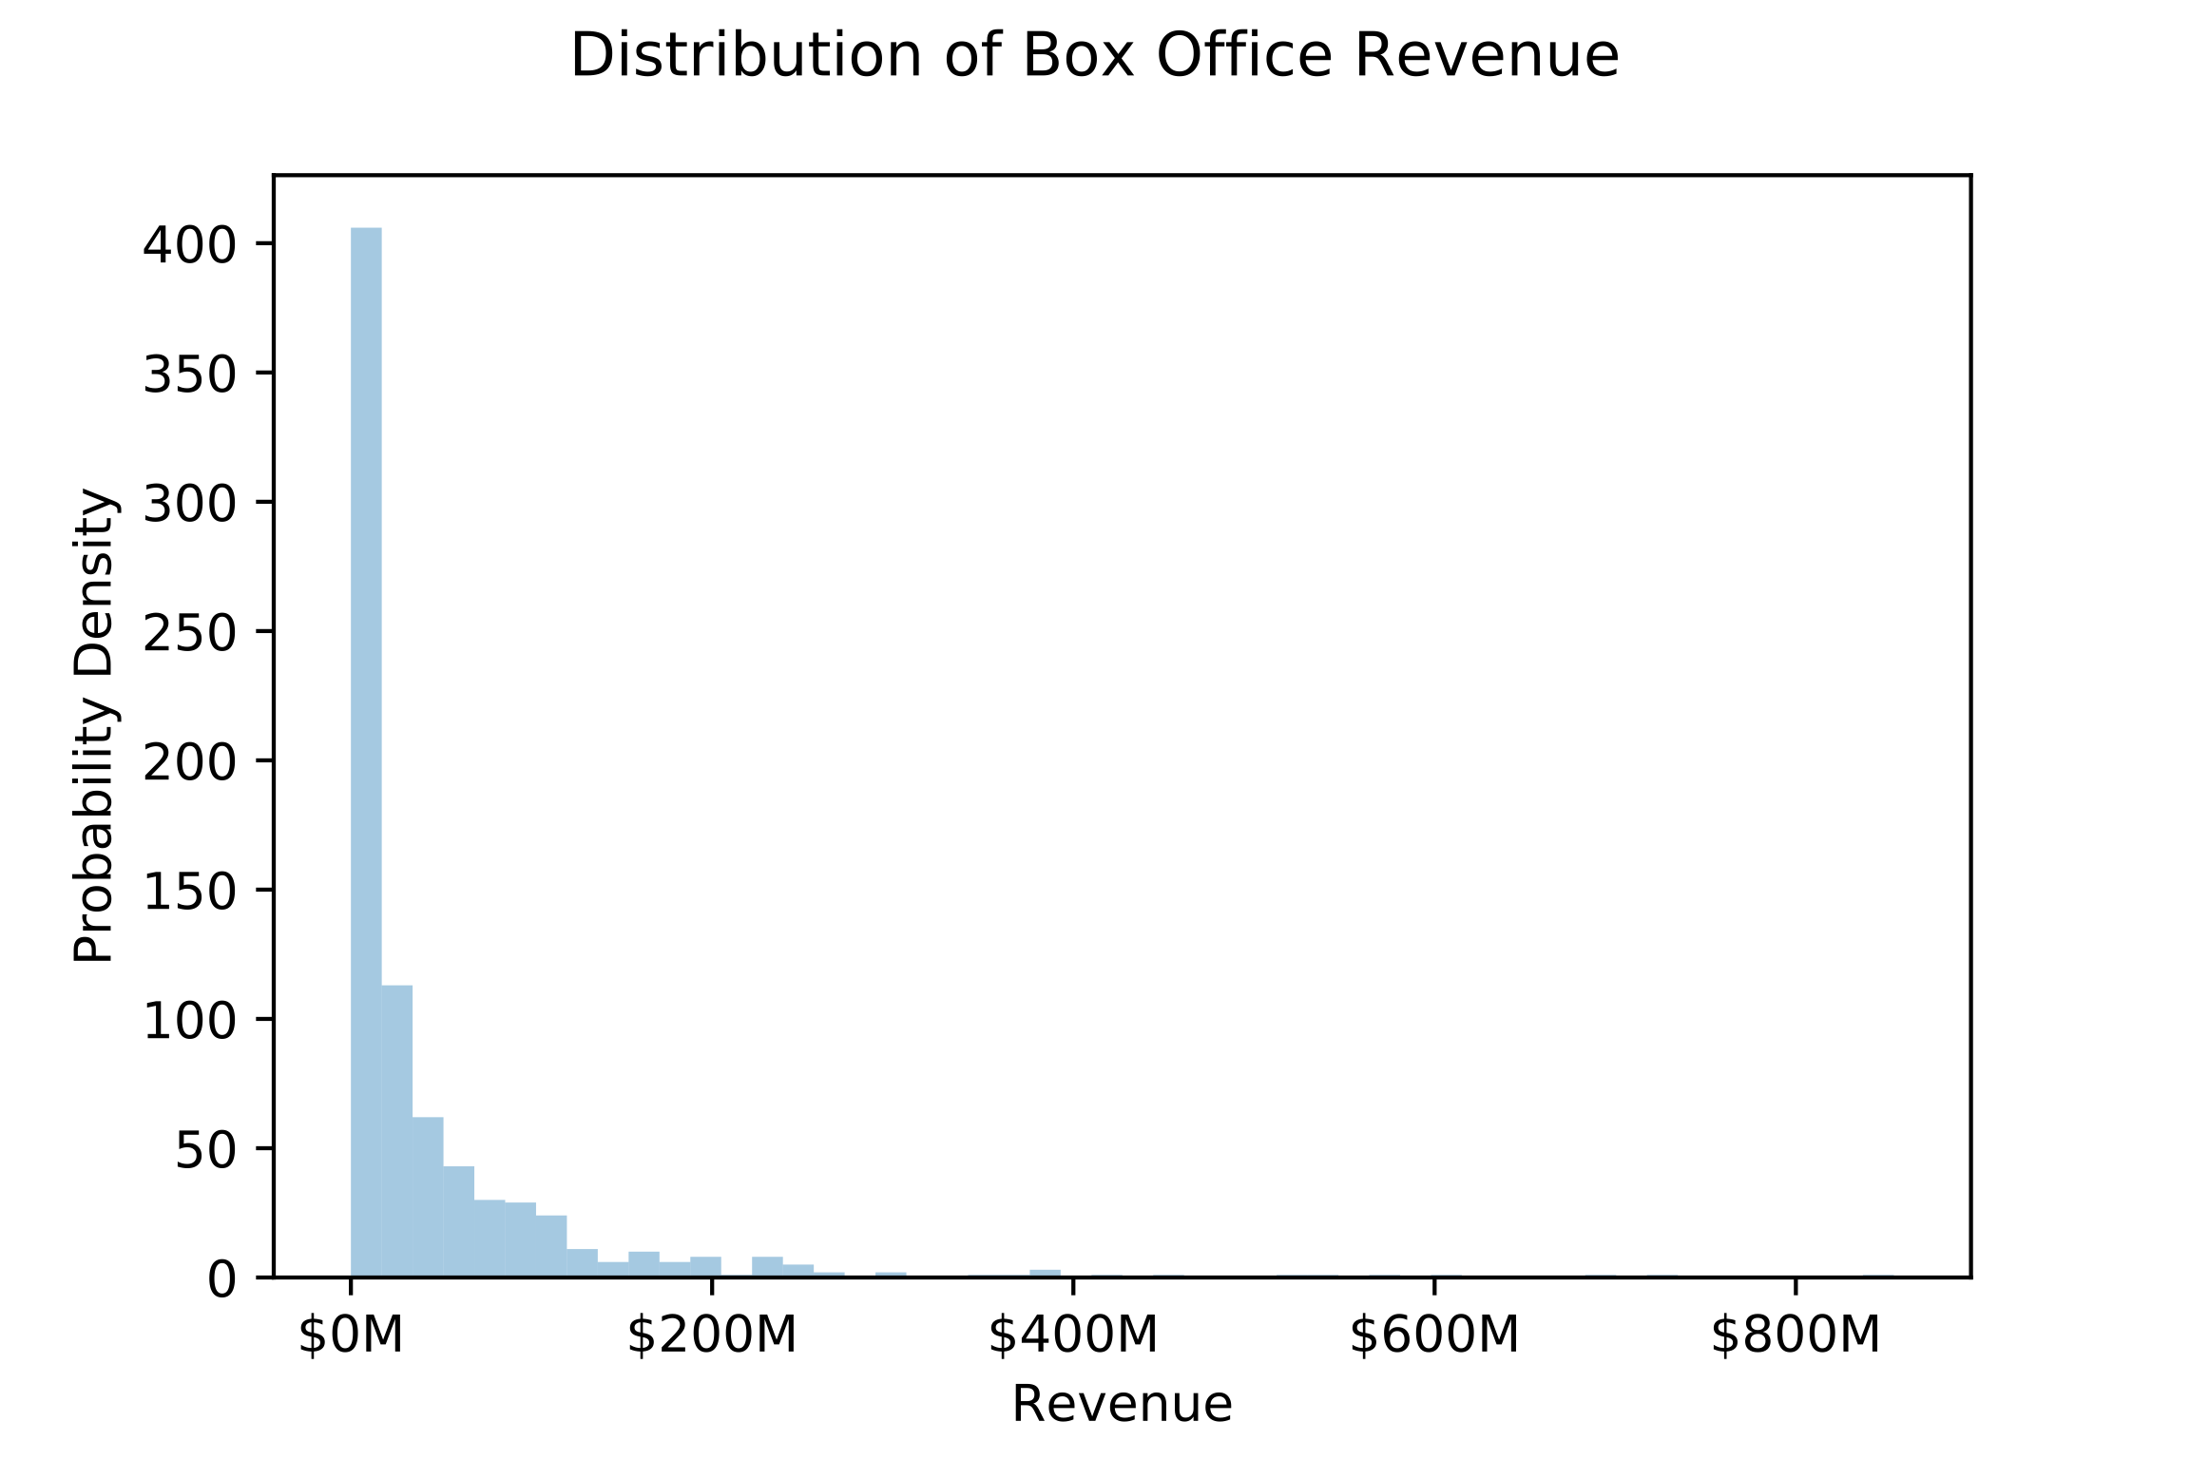
Target variable: box office revenue
Challenges:
Target variable distribution heavily skewed.
Lack of strong correlation
Imputing missing data
Min: $2,829
l o o o o o o o o o n g tail
Max:
$854,248,869

Slide 7

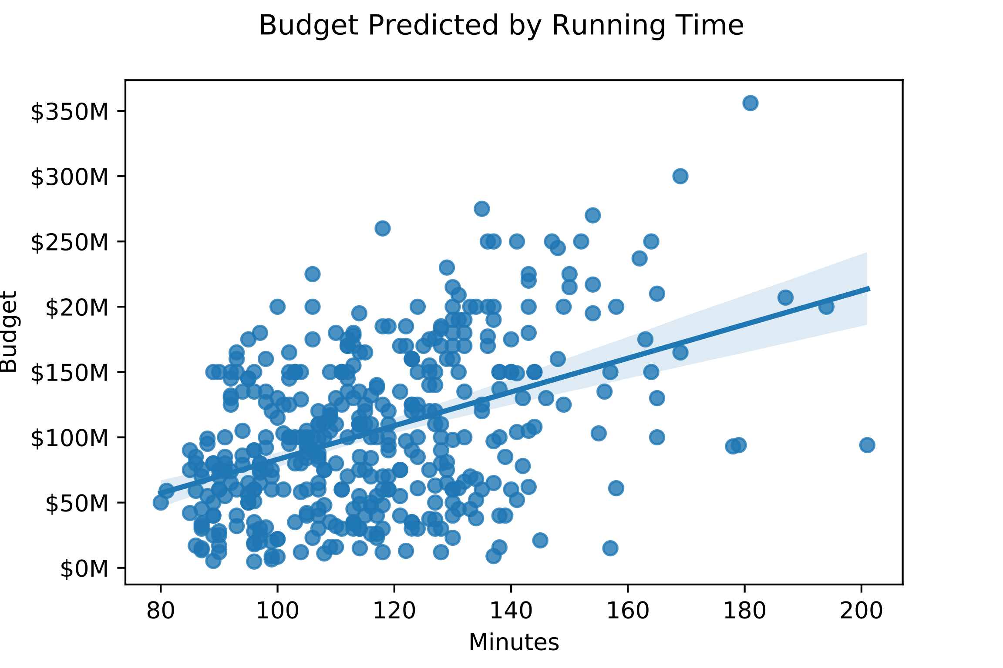
A model within a model…
Problem:
Budget influential to revenue prediction but nearly 50% of films missing budget info
Solution:
Constructed linear regression model that could predict budget based using:
Running time (see right), Genre, Worldwide gross revenue, Cast
Results:
2/3 of budget variance can be explained by model
R^2 = 0.676
Predictions accurate within margin of ~$26M
MAE = 25,779,893

Slide 8
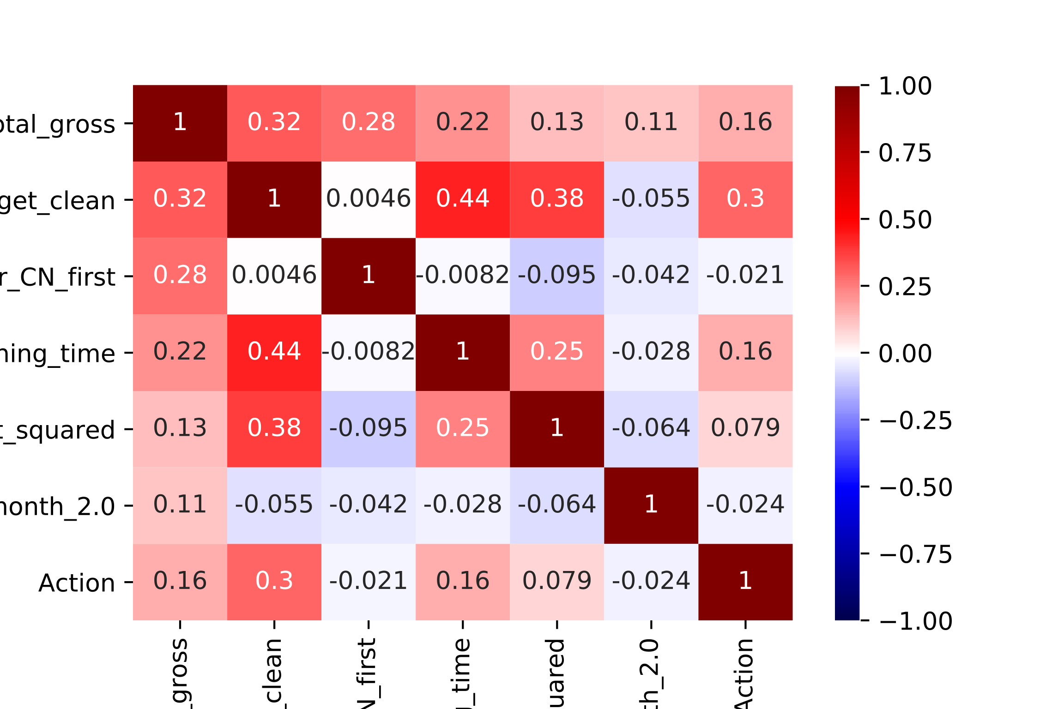
Key factors influencing revenue
Correlation
Revenue
Budget
Release order
Running time
Star Count ^2
February
Action
Used domain knowledge and experimentation to engineer and select features with best correlation with revenue
A/B tested many combos using R^2 to judge result
Data set too small to benefit from regularization and/or widespread polynomial feature adoption
Not pictured: many, many features that were left on the cutting room floor
Revenue
Budget
Release order
Running time
Star Count ^2
February
Action

Slide 9
RESULTS

Slide 10
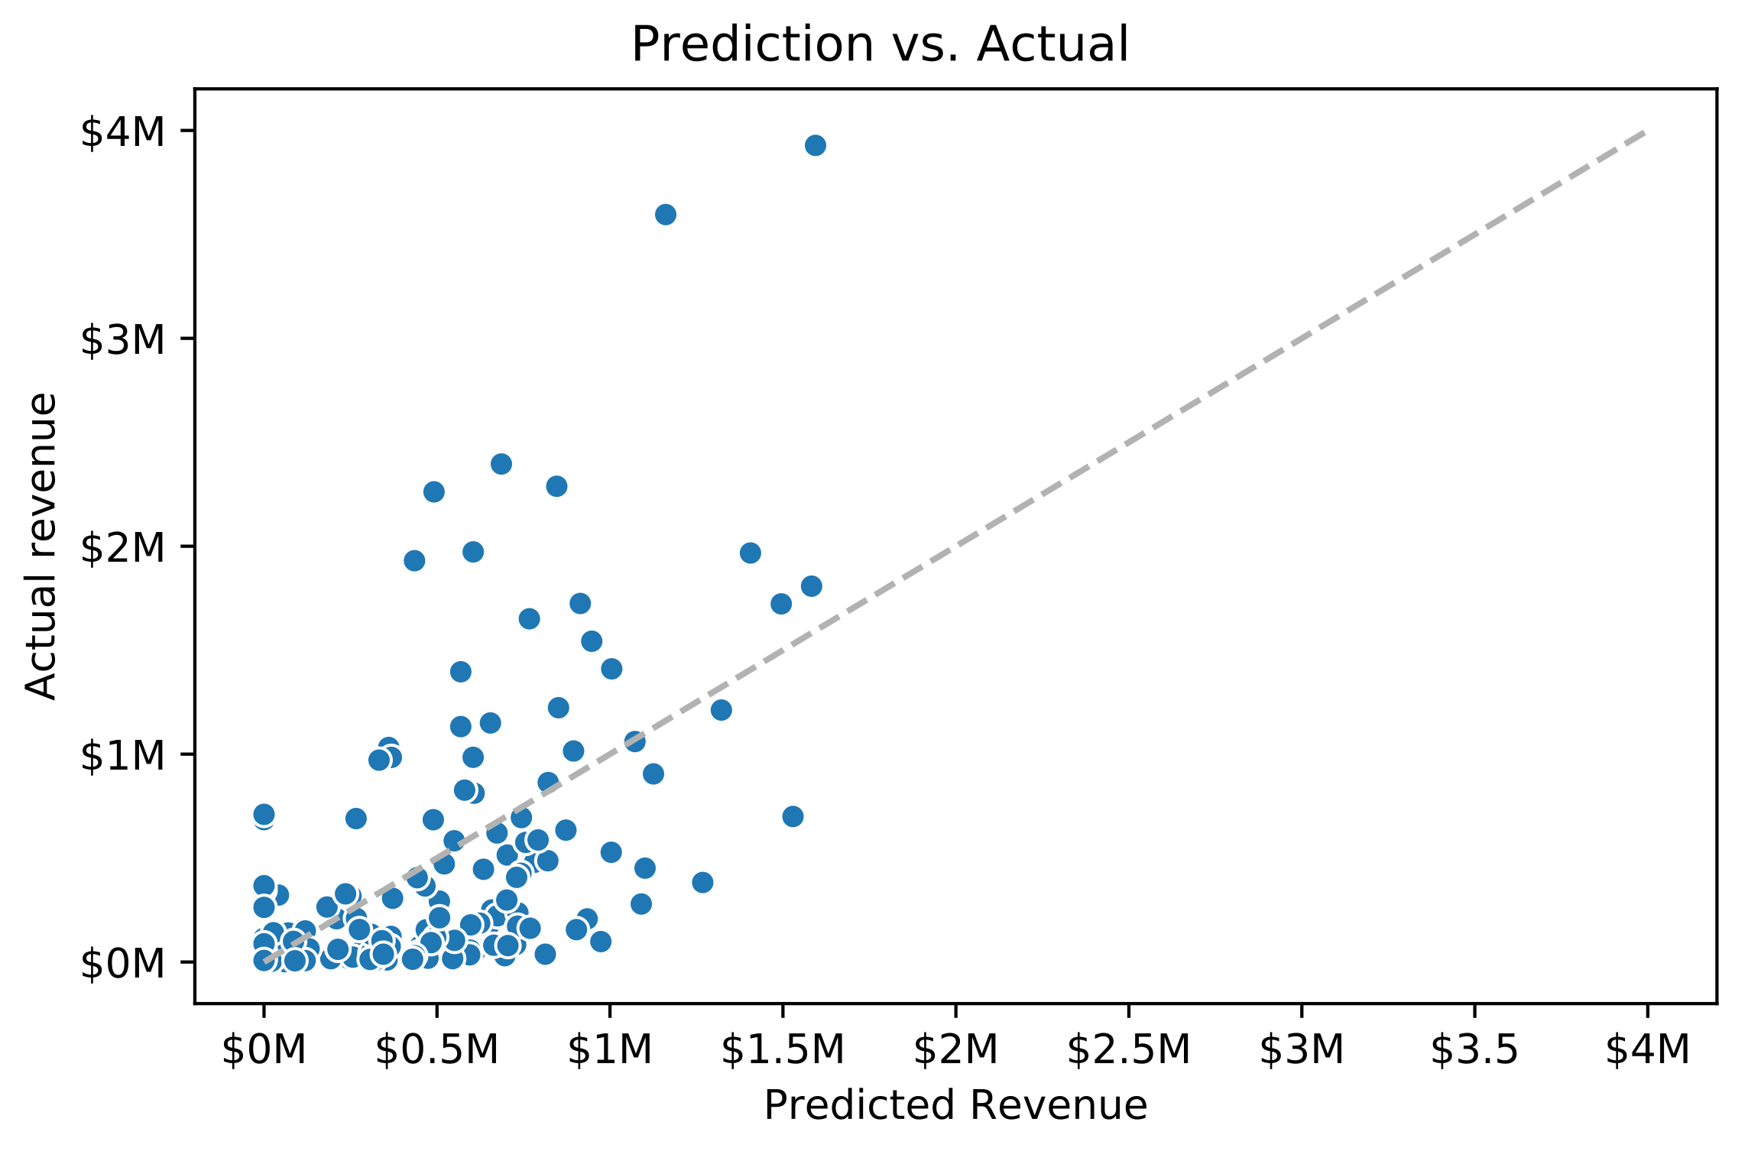
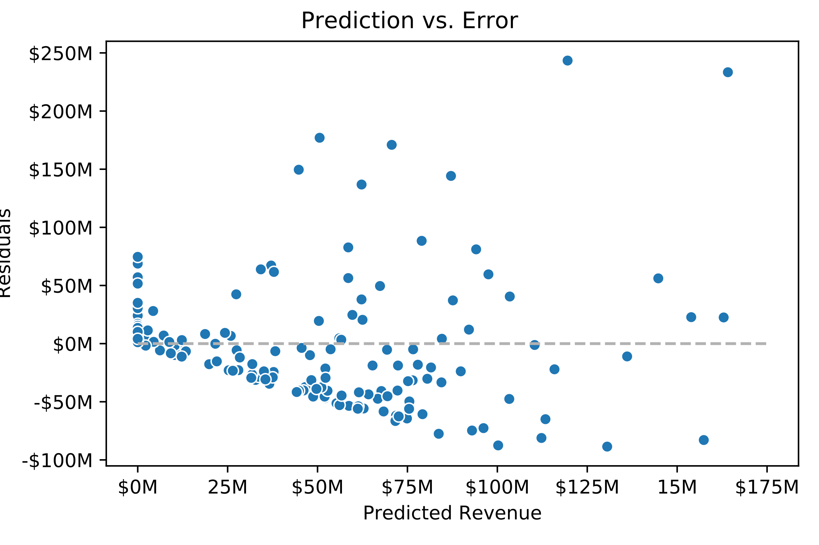
Revenue Predictions
Results:
30% of revenue variance can be explained
by model
R^2 = 0.306
Predictions accurate within ~$38 million
MAE = 38,373,286
Analysis:
Overpredicted smaller films and underpredicted whales
Model’s strength lies in interpretation of feature strength rather than revenue prediction

Slide 11
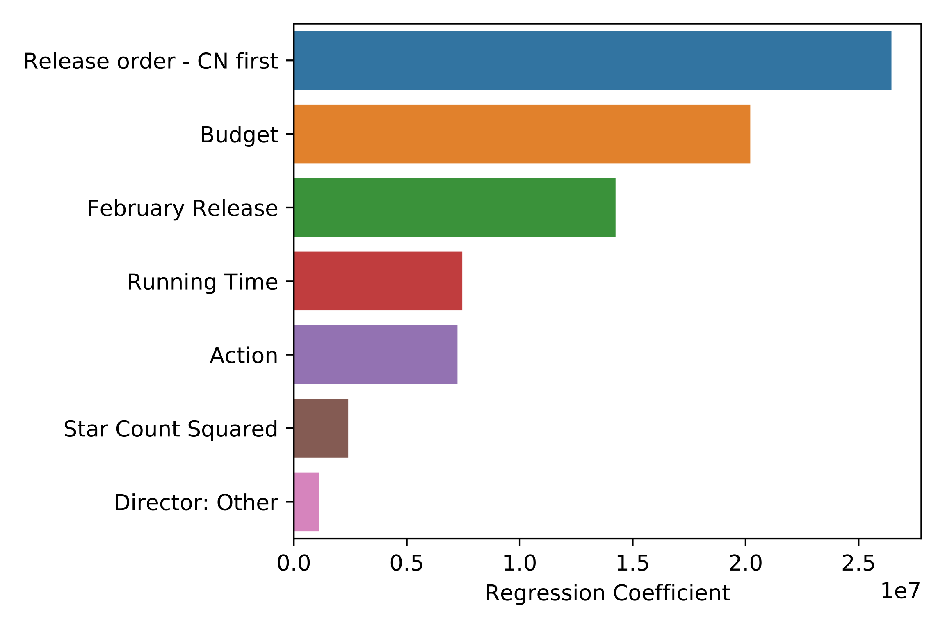
Strategic insights
Model Feature Strength
KEY TAKEAWAYS:
Timing matters
Release during Lunar New Year
Don’t delay Chinese release
High budget yields high revenue
Action translates to foreign audiences easily

Slide 12
CONCLUSION

Slide 13

Conclusion
Chinese film market requires specific strategic considerations, including
Timing
Spend
Genre
Revenue is difficult to predict, but attempting to do so yields valuable insights for successfully marketing international films

Slide 14
Next steps
Extrapolate
Extrapolate insights from broader international film market data and extend to analysis of Chinese market
Add
Continue to add features
Chinese reviews/ratings (douban.com)
Update
Incorporate new film data as it becomes available
Chinese cast
Comparisons with domestic Chinese films

Slide 15
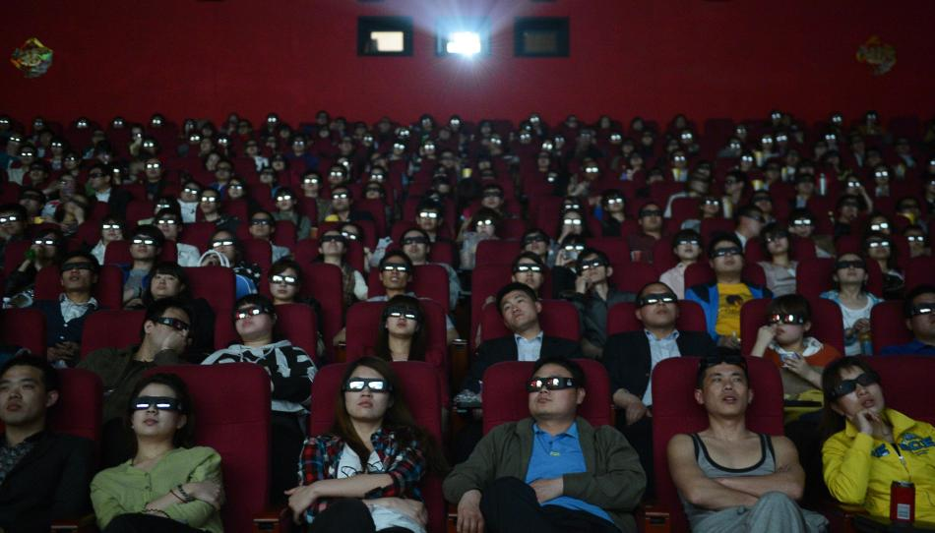
Questions?

